Slide 1



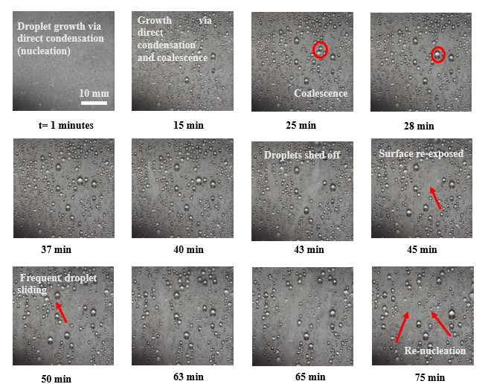
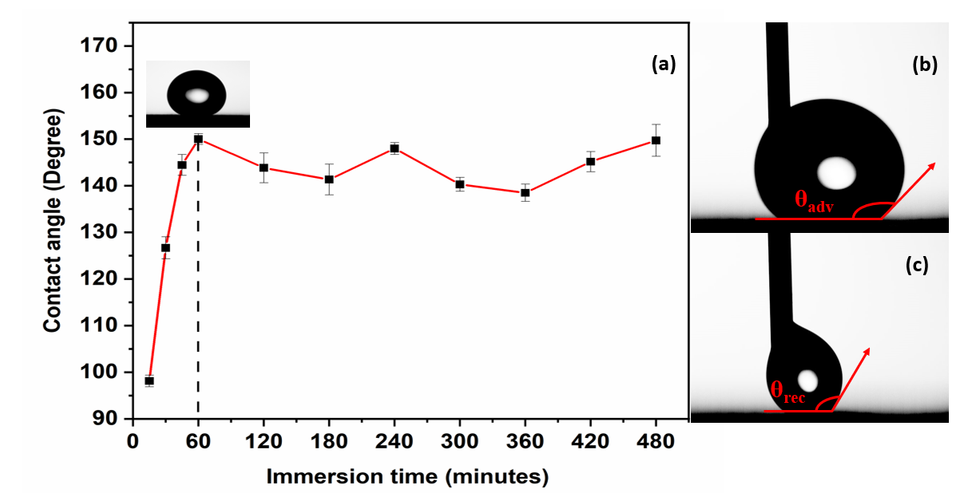

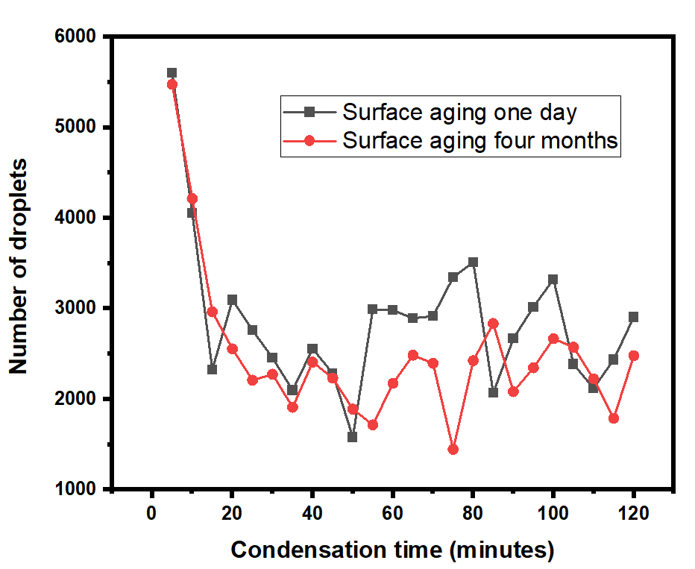
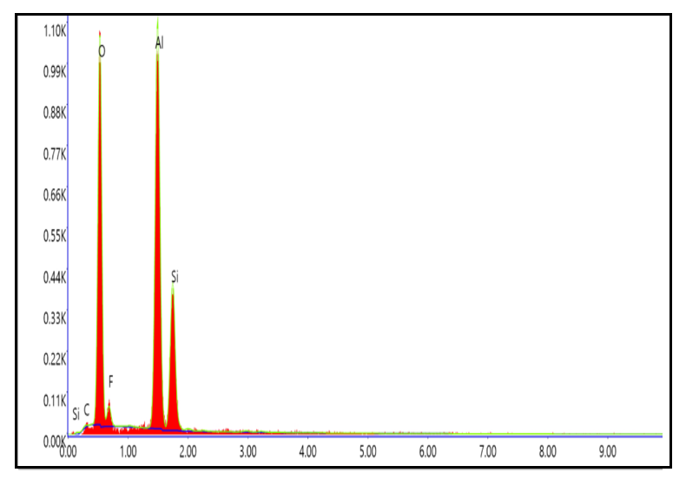

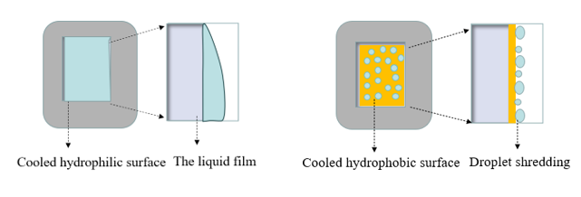

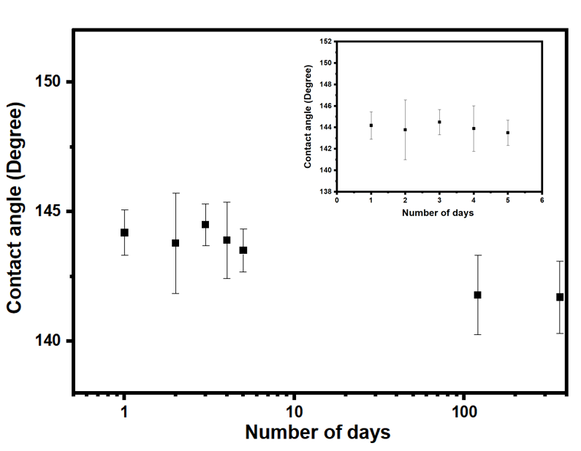
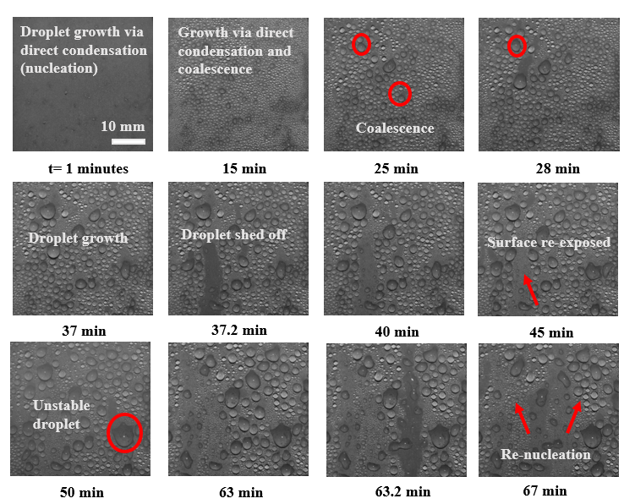
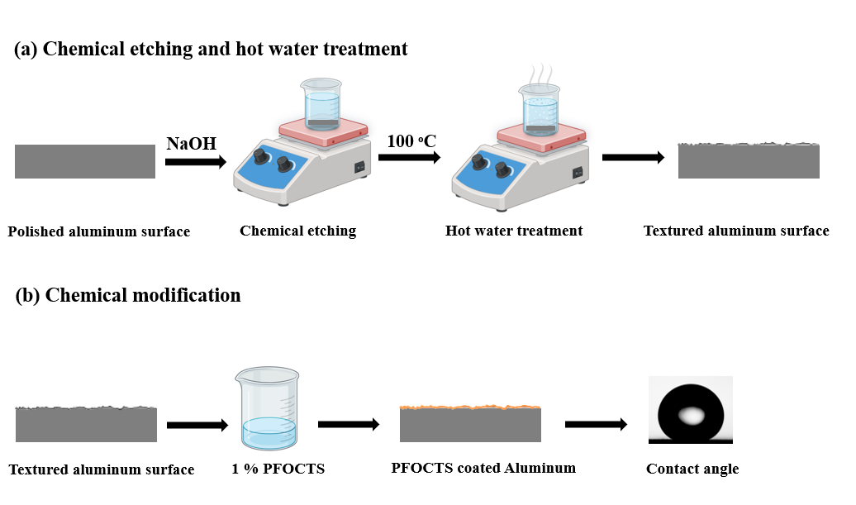
The 4th Biennial International Conference on
Future Learning Aspects of Mechanical Engineering
31st July to 2nd August 2024
Paper ID: 411
Two Step Method for Fabrication of Superhydrophobic Aluminum Surface
FLAME
2024
Smile Kataria^{1,2}, Basant Singh Sikarwar*², Sumant Upadhyay¹, Ranjit Kumar³, Dinesh G Thakur⁴
¹Amity Institute of Nanotechnology, Amity University, Noida, Uttar Pradesh, India, 201301
²Department of Mechanical Engineering, Amity University, Noida, Uttar Pradesh, India, 201301
³ Center for Advanced Materials, Department of Chemical Engineering, Shiv Nadar Institution of Eminence, Delhi-NCR, India 201314
⁴ Department of Mechanical Engineering, Defence Institute of Advanced Technology (DU), Pune, Maharashtra, India, 411025
Corresponding author: bssikarwar@amity.edu
ABSTRACT
RESULTS
Results Cont…
Fabrication of superhydrophobic metallic surface is an emerging area of research for enhancing the condensation rate in atmospheric water generators (AWGs). In this manuscript two step method is proposed for the fabrication of superhydrophobic aluminum surface. The contact angle and its hysteresis of the water droplet was measured, revealing a contact angle of 150ᵒ±1º with hysteresis of 7.5ᵒ±2º. The elemental analysis of fabricated superhydrophobic was carried out using energy dispersive X-ray spectroscopy (EDAX), indicating the presence of Si, C, F, and O over the surface of aluminum. In addition, durability of the fabricated superhydrophobic surface and its applicability for moist air condensation were analyzed. The present results show the surface is stable for the range of contact angle of 142±3ᵒ for a year. The spatial-temporal pattern of condensation shows that the droplet frequently grows and slides-off for re-exposing the surface for re-nucleation with respect to aging of surface.
Water contact angle, hysteresis and contact angle optimization
Figure 3 illustrates the influence of immersion time on the contact angle, revealing the highest contact angle 150ᵒ at 1 hour and advancing and receding contact angles for the optimized sample were 145ᵒ and 134.5ᵒ respectively with the low contact angle hysteresis of 7.5ᵒ
Figure 7 Spatio-temporal droplet distribution on aluminum surface’s at four months aging
Figure 3 (a)Variation of contact angle with respect to immersion time of surface in the solution. (b) advancing contact angle. (c) receding contact angle.
INTRODUCTION
Surface elemental composition
Figure 4 illustrates EDAX spectra, showing presence of elements such as of Si, C, F, and O over the surface of aluminum and Table 1 shows elemental atomic and weight % of the identified elements over the aluminum surface.
Condensation is a biphasic process involving significant heat transfer as vapor converts to liquid upon contact with a cooled condensing surface
Hydrophilic surface have contact angle less than 90ᵒ whereas surfaces with the contact angle in between 90ᵒ< θ <140ᵒ are termed as hydrophobic surface. However, superhydrophobic surfaces have contact angles exceeding 150ᵒ
Filmwise condensation occurs on hydrophobic surface and dropwise condensation occurs on hydrophobic/super-hydrophobic surface as shown in Figure 1.
Hydrophilic metallic surfaces offer limitations on vapor condensation due to the large thermal resistance offered by the continuous water film formed during condensation which acts as barrier to condensation
Herein, we used two step method for the fabrication of stable and durable superhydrophobic aluminum surface. Firstly, to fabricate two-tier hierarchical textures using chemical etching and hot-water treatment, and further chemical modification with 1H, 1H, 2H, 2H- perfluorooctyl trichloro silane (PFOCTS)
Sr No. | Elements | Weight % | Atomic %
1 | C | 0.65 | 1.15
2 | O | 36.96 | 49.29
3 | F | 2.35 | 2.63
4 | Al | 42.05 | 33.25
5 | Si | 18.00 | 13.67
Figure 8 Number of droplets generation with respect to condensation time on one day aging and after four months aging.
Figure 4 Energy dispersive X-ray spectra of fabricated superhydrophobic surface and Table 1 show elemental composition of the proposed surface
CONCLUSIONS
Durability Test
Figure 5 shows durability of the proposed surface upon immersion in tap water.
Proposed surface has contact angle of 150ᵒ±1ᵒ with low contact angle hysteresis 7.5ᵒ±2ᵒ
The superhydrophobic surface demonstrated efficient removal of condensate and providing fresh surface to re-nucleate vapors over the surface.
Prepared surface is durable for one year. However, surface’s wetting behavior changes from superhydrophobic to hydrophobic over time.
Condensation experiments were conducted initially, and then repeated after four months and observed there was no variation in droplet generation.
In both cases droplets slide-off in the same frequency and the distribution of drop achieved stable dynamic state.
Figure 1 Mode of condensation on hydrophilic and hydrophobic surface.
METHODOLOGY
Figure 5. Sustainability of the surface in terms of contact angle from the day of fabrication.
Condensation experiment
Figure 6 and Figure 7 depicts condensation phenomena on the fabricated aluminum surface on one day and 4 months aging respectively at relative humidity of 85% and degree of sub cooling 10 ᵒC.
REFERENCES
Figure 2 shows two-step method for the fabrication of superhydrophobic aluminum surface using (i) chemical etching and hot water treatment (ii) salinization using 1H, 1H, 2H, 2H- perfluorooctyl trichloro silane.
Jeevahan J, Chandrasekaran M, Britto Joseph G, et al (2018) Superhydrophobic surfaces: a review on fundamentals, applications, and challenges. J Coat Technol Res 15:231–250. https://doi.org/10.1007/s11998-017-0011-x
Goswami A, Pillai SC, McGranaghan G (2021) Surface modifications to enhance dropwise condensation. Surf Interfaces 25:101143. https://doi.org/10.1016/j.surfin.2021.101143
Lata Singh P, Singh Sikarwar B, Ranjan M, Muralidhar K (2022) Enhancing dropwise condensation of vapor from moist air over a copper substrate by temperature-controlled chemical etching. Therm Sci Eng Prog 34:101403. https://doi.org/10.1016/j.tsep.2022.101403
Nagar A, Kumar R, Srikrishnarka P, et al (2021) Scalable Drop-to-Film Condensation on a Nanostructured Hierarchical Surface for Enhanced Humidity Harvesting. ACS Appl Nano Mater 4:1540–1550. https://doi.org/10.1021/acsanm.0c03032
Li R, Li M, Wu X, et al (2023) A pine needle-like superhydrophobic Zn/ZnO coating with excellent mechanochemical robustness and corrosion resistance. Mater Des 225:111583. https://doi.org/10.1016/j.matdes.2022.111583
ACKNOWLEDGEMENT
Figure 2 Schematic diagram illustrating the sequential processes and techniques used to fabricate superhydrophobic aluminum surface.
Figure 6 Spatio-temporal droplet distribution on aluminum surface’s at one day aging.
We acknowledge Science & Engineering Research Board (SERB), India to provide financial assistance to carry out this work, Grant No. CRG/2021/005669.

